Slide 1
Kinematics and Dynamics of Robots
Spring Semester 2021
Lecturer: Yoav Golan

Slide 2
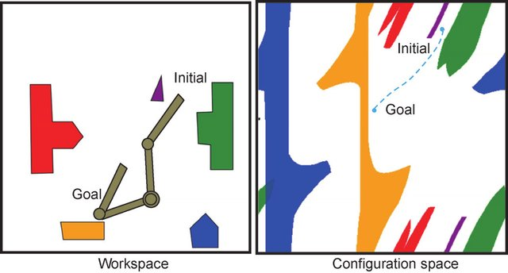
Path Planning

Slide 3
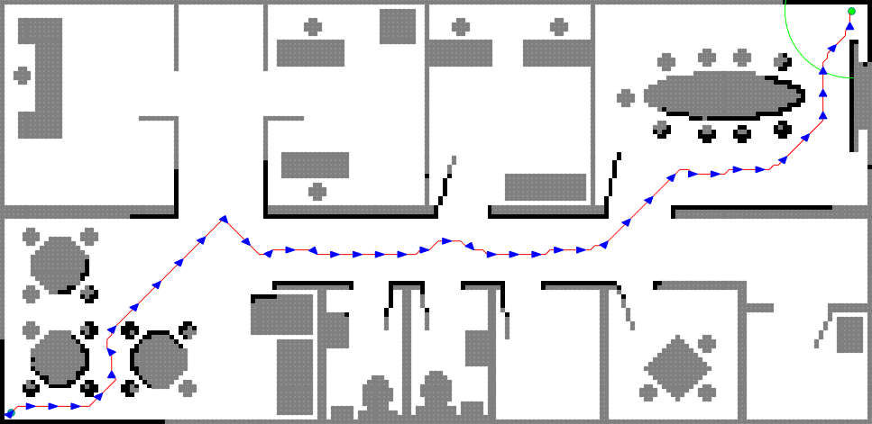
Path Planning

Slide 4

Discrete Path Planning

Slide 5
Discrete Path Planning
Complete/Admissible
Complete = Will find a solution if it exists
Admissibility = Will find the optimal solution if it exists
Works well for n<4

Slide 6
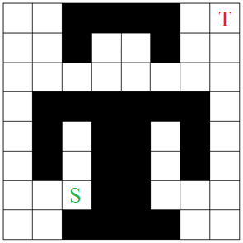
Discrete Path Planning Example - BFS

Slide 7
Non-Discrete Path Planning
Stochastic
Analytic

Slide 8
Stochastic Path Planning
Based on random “guesses”
Not Complete (will not always find a path if it exists)
Asymptotically optimal

Slide 9
Analytic Path Planning
Can be Complete
Not optimal
Hard to synthesize

Slide 10
Analytic Path Planning – Artificial Potential Fields
Create an artificial potential field
Every point in continuous space has a potential
Obstacles have repulsive, high potentials
Target has attractive, low potential

Slide 11
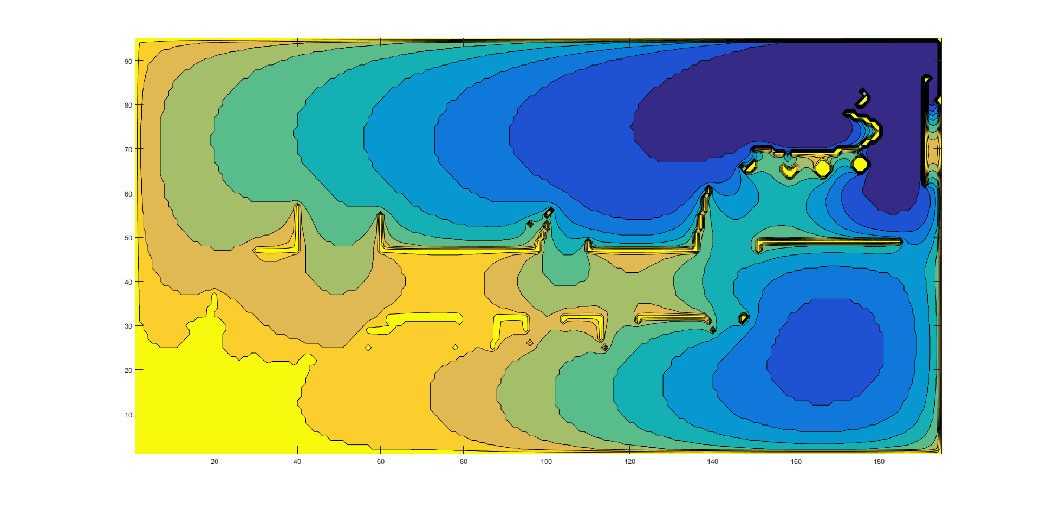
Analytic Path Planning – Artificial Potential Fields
Target is reached by gradient descent

Slide 12
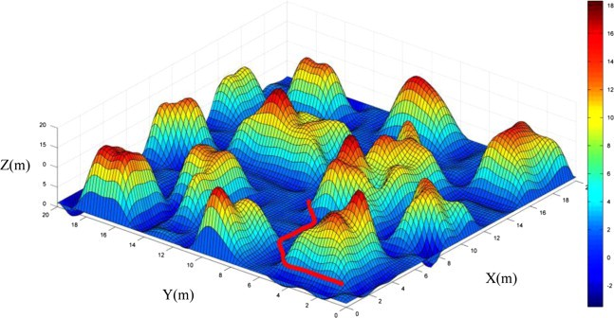
Analytic Path Planning – Artificial Potential Fields
Target is reached by gradient descent

Slide 13
Analytic Path Planning – Artificial Potential Fields
Video

Slide 14
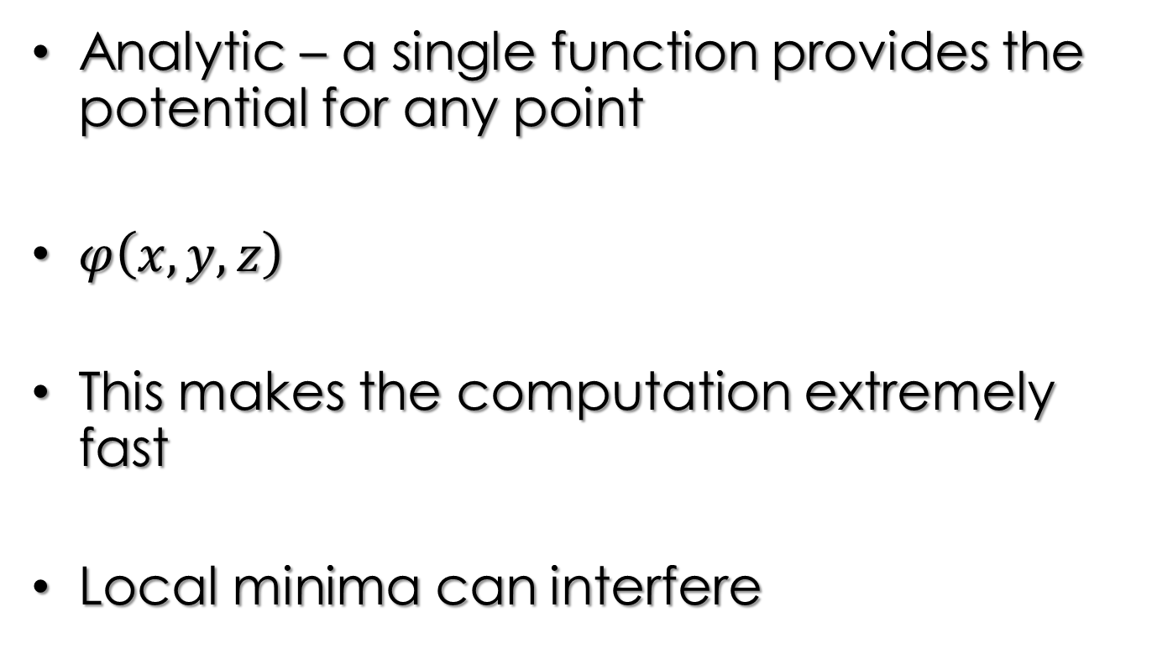
Analytic Path Planning – Artificial Potential Fields
Analytic – a single function provides the potential for any point
$φ\left(x,y,z\right)$
This makes the computation extremely fast
Local minima can interfere

Slide 15
Analytic Path Planning – Artificial Potential Fields

Slide 16
Stochastic Path Planning
Based on random “guesses”
Many, many variants
Two leaders for robotic arms: RRT, PRM

Slide 17
Stochastic Path Planning - RRT
RRT = Rapidly-exploring Random Tree
Single query – Finds a path from a start point to a target point, but nothing else
Popular variants: RRT*, Bi-Directional RRT

Slide 18
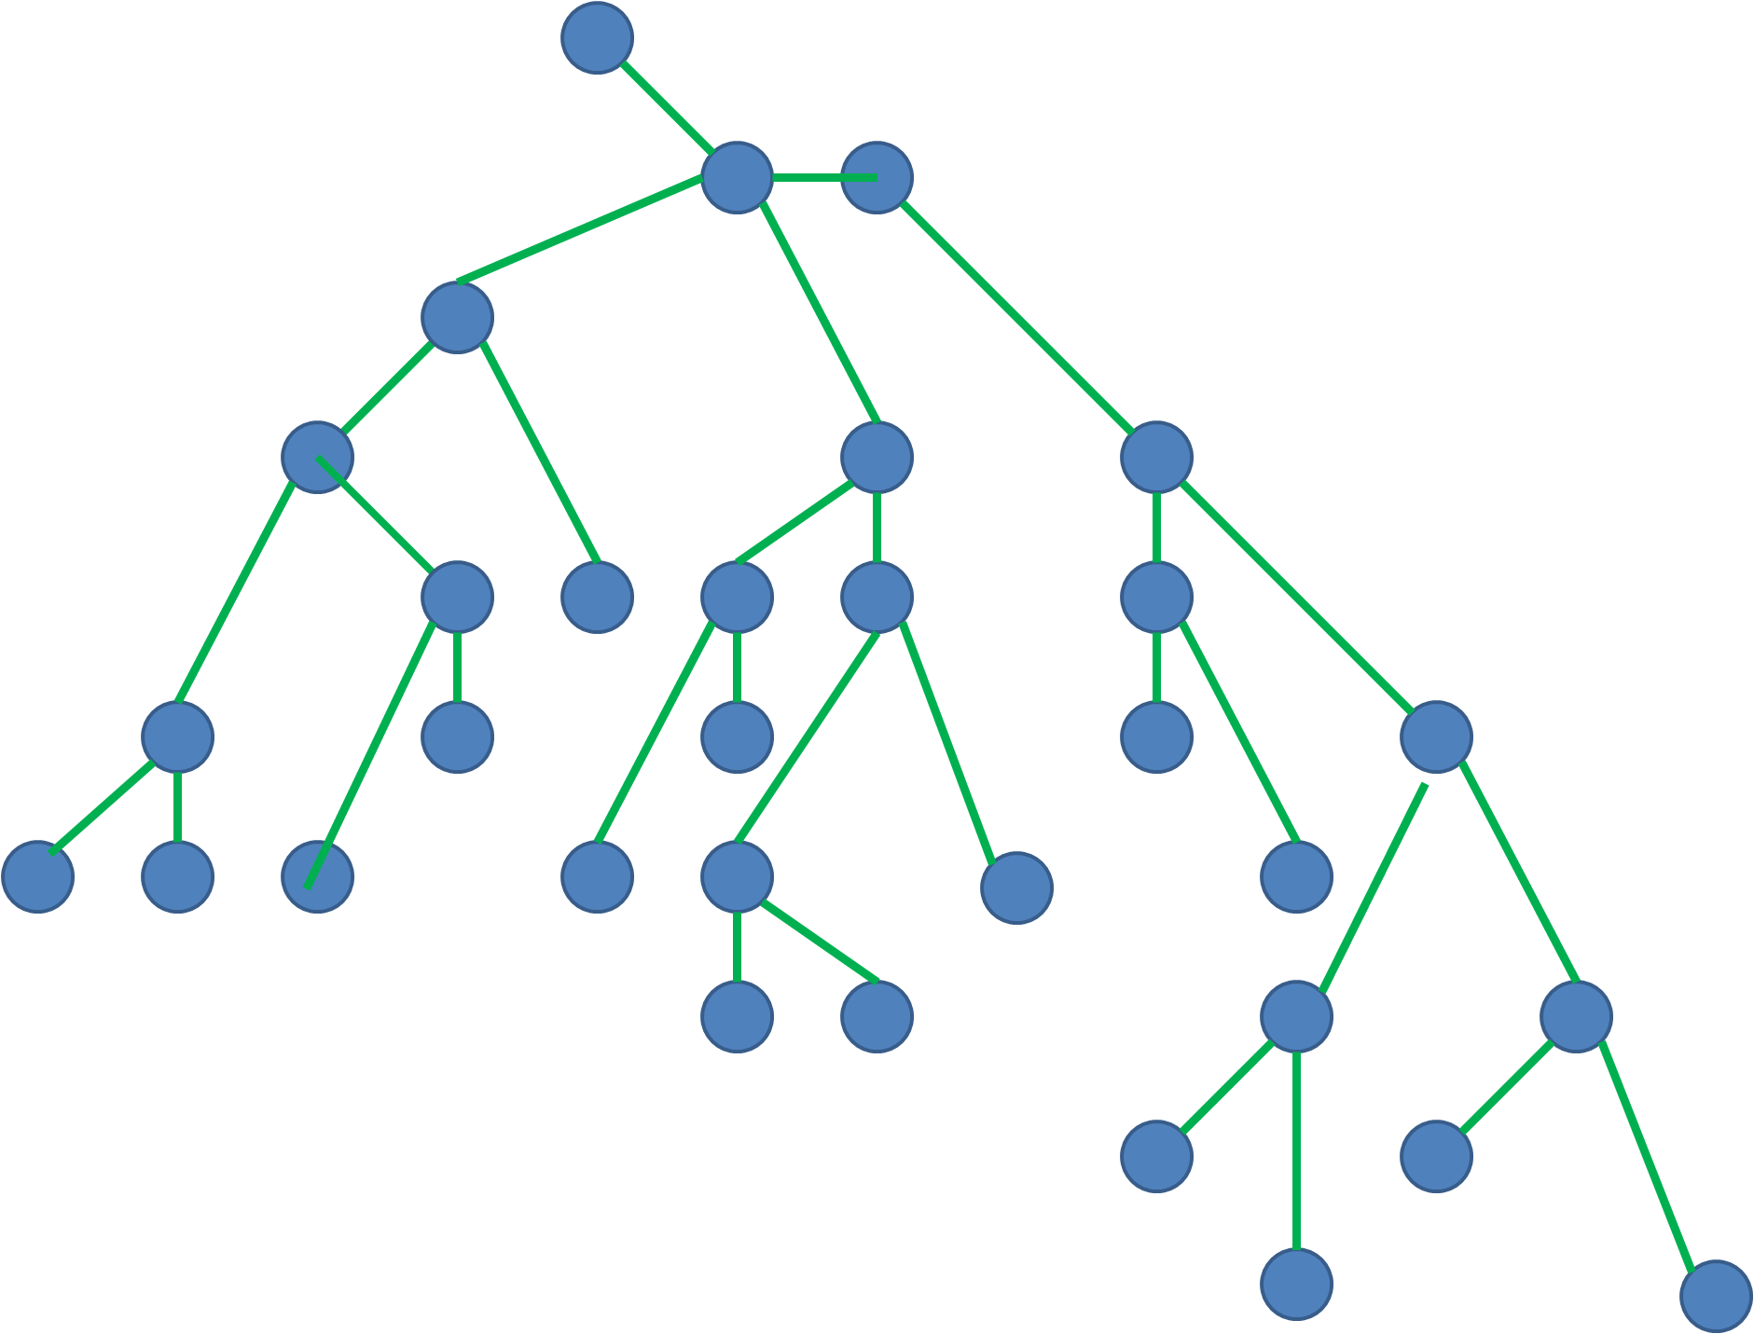
Stochastic Path Planning - RRT
Uses a Tree
A Tree is a type of graph that contains no cycles

Slide 19
Stochastic Path Planning - RRT
Each Node has one Parent
Each Parent Node may have multiple Children

Slide 20
Stochastic Path Planning - RRT
In a Tree, there is only one path between two Nodes

Slide 21

RRT
S
T

Slide 22
RRT
Inputs:
Step size
Maximum number of nodes
Exploration bias (not mandatory)

Slide 23
RRT
Create a Root Node at the Start
Create a “Target zone” around the Target
Select a random configuration
3.1. Find the nearest Node
3.2. Create a temporary Node that is the step distance away from the nearest node, in the direction of the random configuration
3.3. Check if the temporary node collides with an obstacle. If not, add the node to the tree
3.4. If the added node is in the Target zone, stop search.
4. Create a path from the Target to Start by going up the Tree.

Slide 24
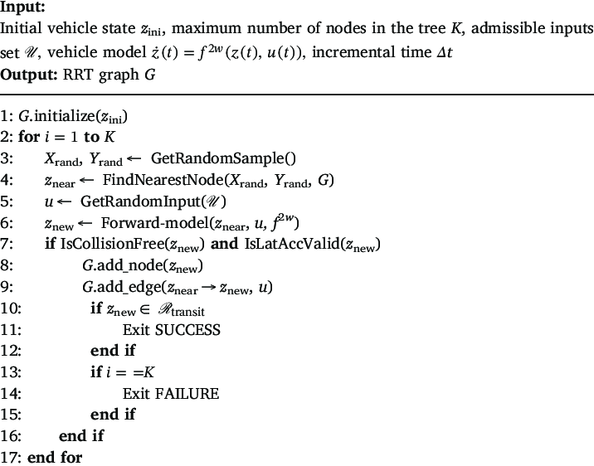
RRT Pseudocode

Slide 25
RRT Helper Functions
PD = pointDistance(Point1,Point2)
Returns the Euclidean distance between two points.
In 2D:
In n-D:
For n=6:

Slide 26
RRT Helper Functions
CN = closestNode(Point,Tree)
Returns the closest node in Tree to Point.
Go over every node in the tree
For each node, find the distance using pointDistance(Tree(i),Point)
Return the node with the shortest distance

Slide 27
RRT Helper Functions
TN = createTestNode(Closest_Node, Point, Step_Size)
Returns a potential node, given a random point Point, the closest node to it Closest_Node, and the step size.
Find the vector from Closest_Node to Point.
Normalize the vector, and multiply it by Step_Size. Let’s call this the Step_Vector.
Return Closest_Node + Step_Vector

Slide 28
RRT Helper Functions
IT = inTarget(Node, Target, Target_Radius)
Answers the question: is Node within Target_Radius from Target?
Find the distance from Node to Target using pointDistance(Node,Target).
If the distance < Target_Radius, return YES, else return NO.

Slide 29
RRT Helper Functions
CC = checkCollision(Node, Obstacles)
Checks if there is a collision between the node and any of the obstacles.
This is possibly the most important function! We will use it for almost any algorithm.
Collision detection is problem-specific.
Examples: 2D, 6D

Slide 30
RRT Helper Functions
CC = checkCollision(Node, Obstacles)
Checks if there is a collision between the node and any of the obstacles.
This is possibly the most important function! We will use it for almost any algorithm.
Collision detection is problem-specific.
Examples: 2D, 6D

Slide 31
RRT Helper Functions
Path = retracePath(Last_Node, Tree, Target)
Finds the path from the last node (near the target) to the Start.
While the current node is not the Root:
Add current node to path
Next node = current node’s parent
Add Target to the end to complete the path

Slide 32
RRT Pseudocode
Create world: Obstacles, Start and Target points.
Define: K, Step_Size, Target_Radius
Tree = Start
For i=1 to K do
Point = Create Random point in the world
Closest_Node = closestNode(Point, Tree)
Test_Node = createTestNode(Closest_Node, Point, Step_Size)
if not checkCollision(Test_Node, Obstacles) do
Add Test_Node to Tree
If inTarget(Test_Node,Target,Target_Radius) do
Path = retracePath(Test_Node,Tree,Target)
return

Slide 33
RRT Exploration Bias
Randomly exploring the world is not very efficient, especially in sparse space
Exploration bias: for each step, in probability P(Exploration_Bias), have the next point be the target.
Else (1-P(Exploration_Bias)), have the next point be a random point.

Slide 34
RRT Variants
RRT* - For each new node, find the shortest path to the start, and restructure the tree.
-Asymptotically optimal
Bi-Directional RRT – grow two trees, one from the start and one from the target. When the two trees meet – a path is found.

